Slide 1

Software 2.0, Abstraction and Gödel’s Incompleteness Theorems
Nate
natitaw.com

Slide 2
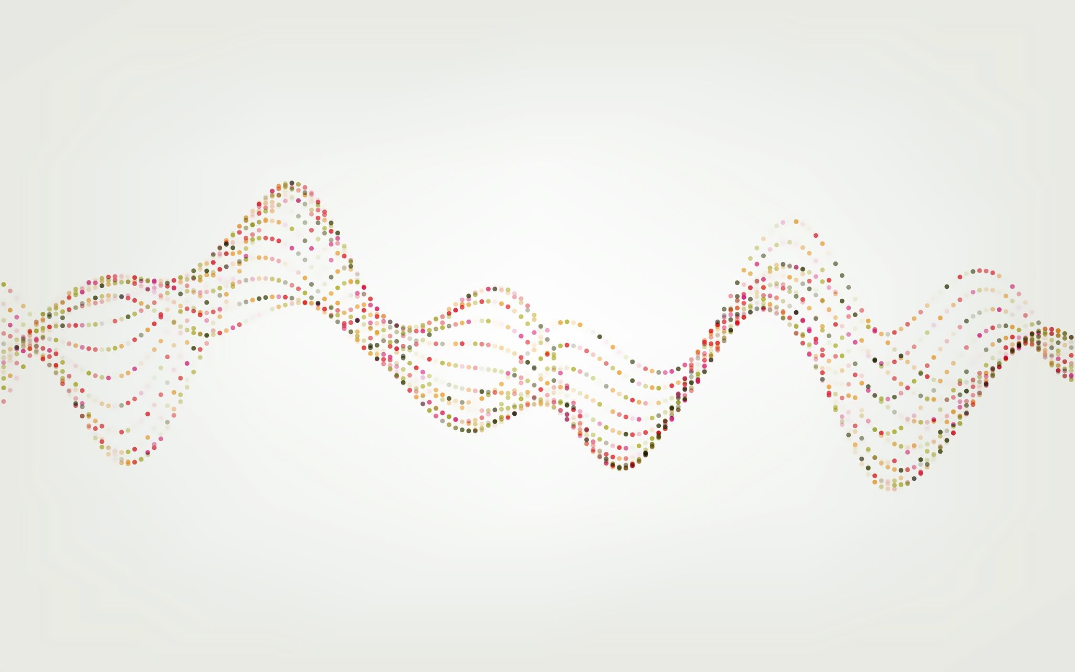
How do we encode information into a computer?

Slide 3
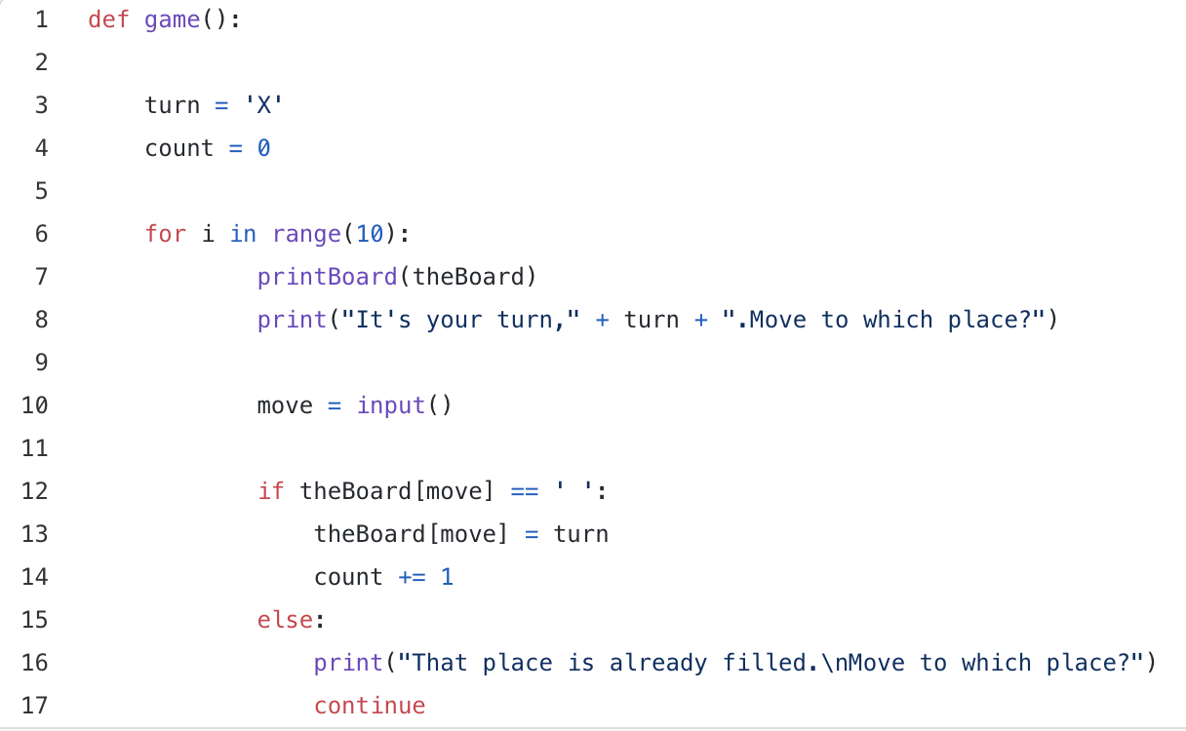
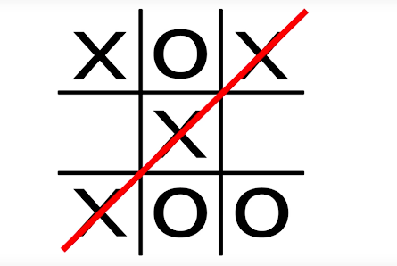
A Simple Case – Tic-Tac Toe
Define Game Boundary
Define Rules
Execute a Search Algorithm

Slide 4
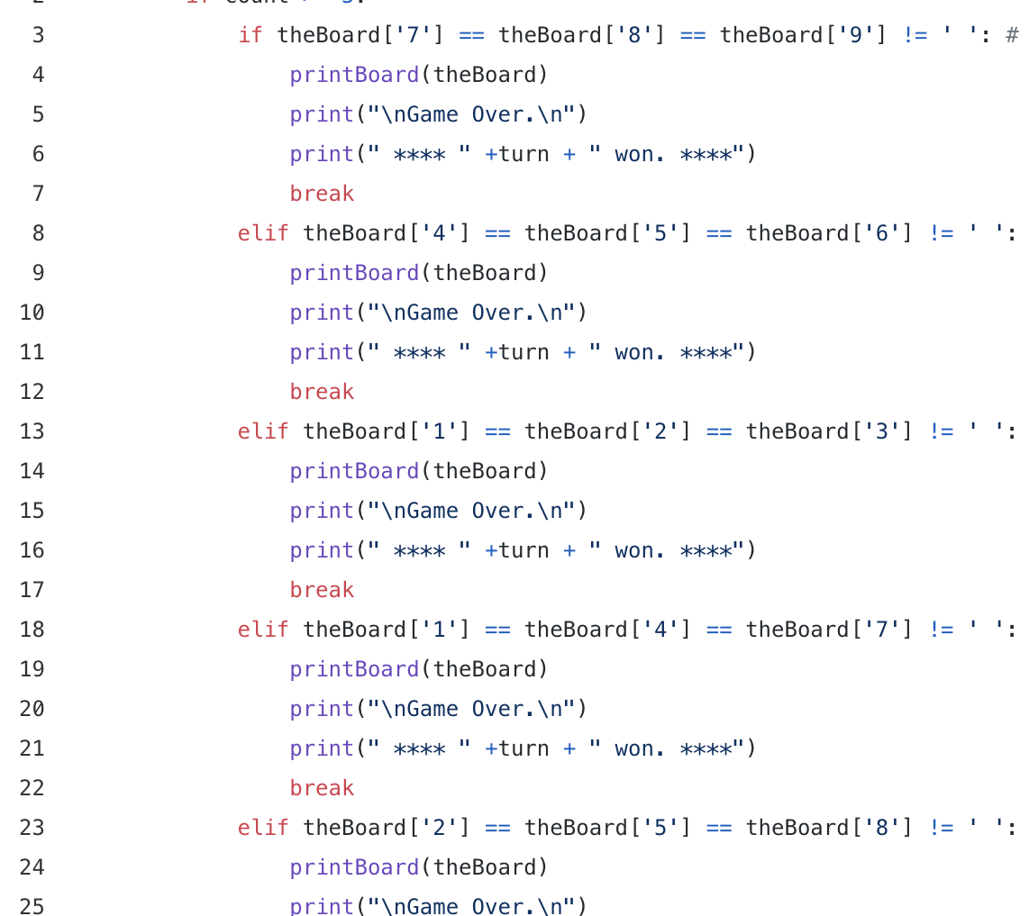
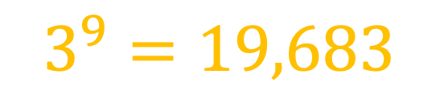
A Simple Case – Tic-Tac Toe
Force Compute
$$3^{9}=19,683$$

Slide 5
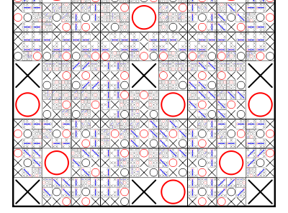
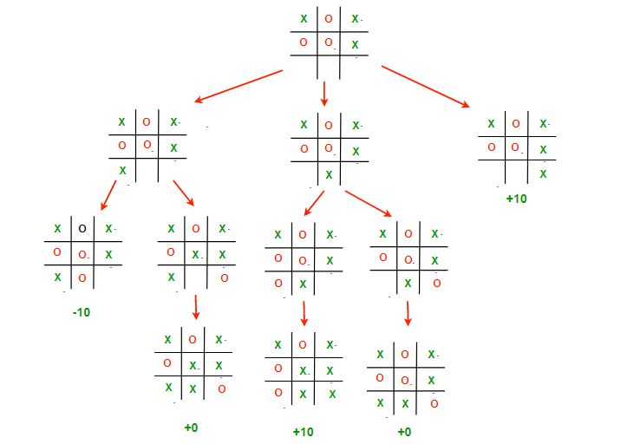
Software 1.0 ✅
Tic-Tac Toe

Slide 6
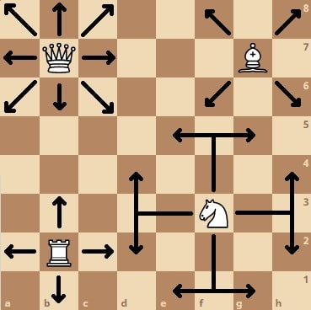
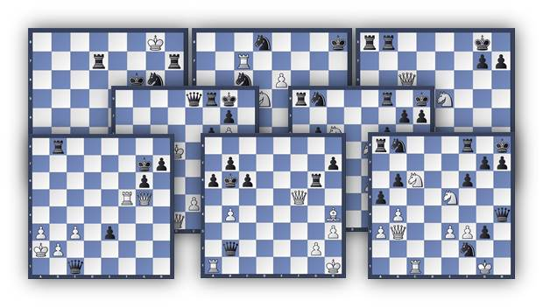
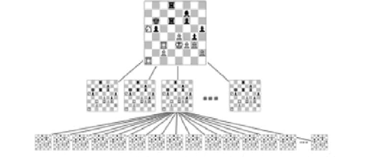
Slight Complication -- Chess
Define Rules
Execute a Search Algorithm

Slide 7
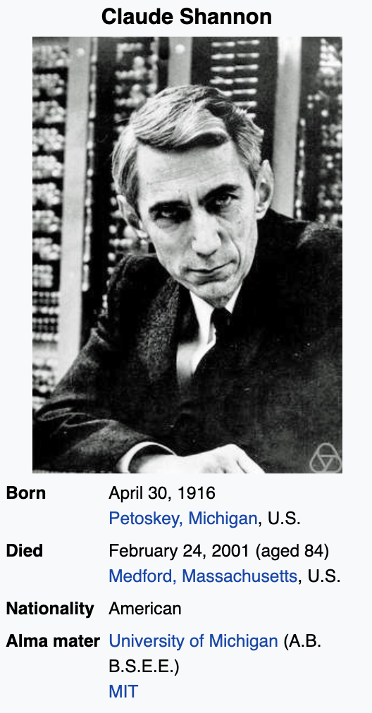
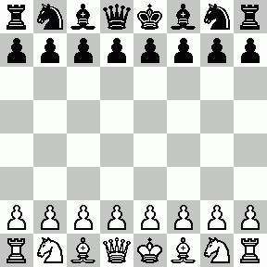
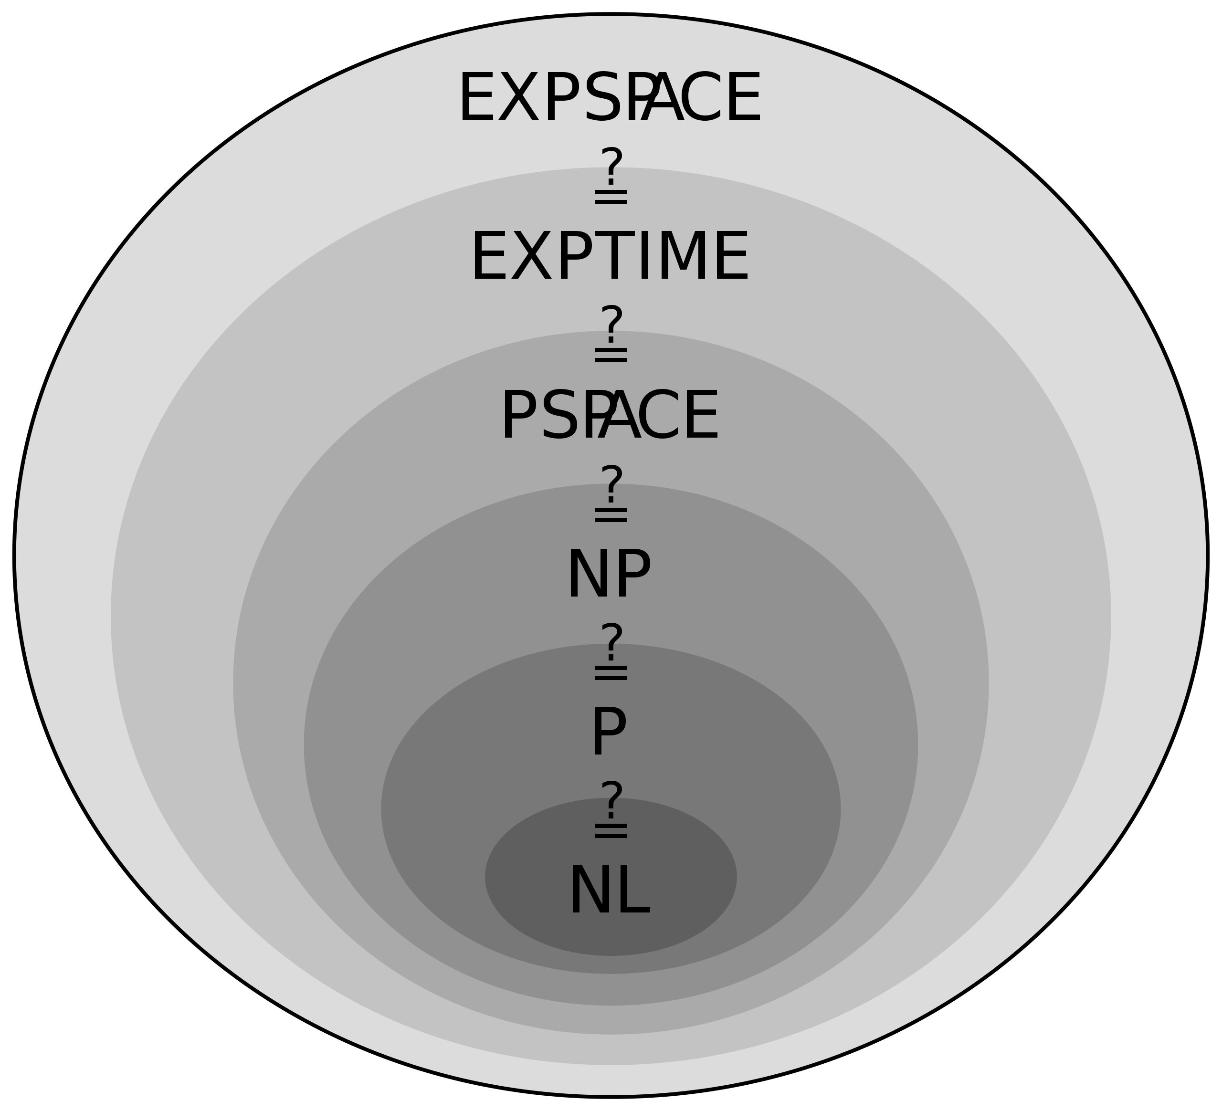
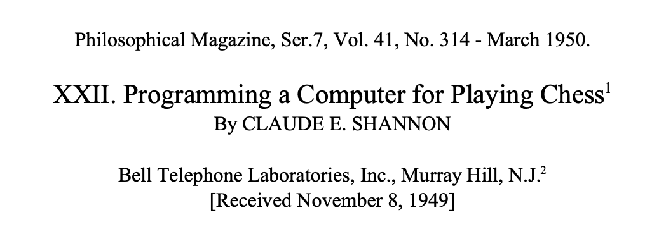
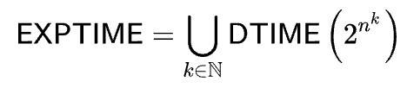
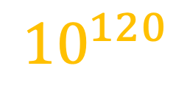
Game-Tree Complexity of Chess
Possible States of Chess
$${10}^{120}$$
Notes:
10 70

Slide 8
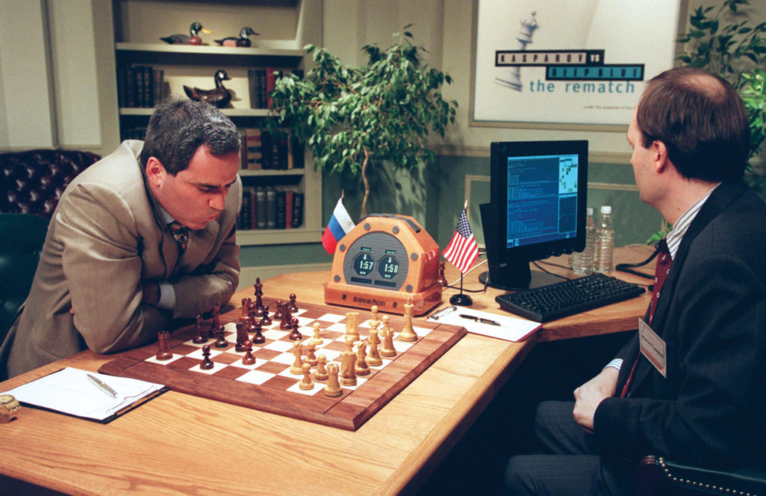
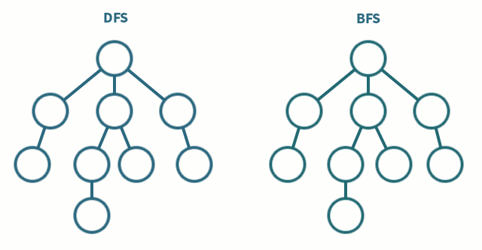

Slide 9
Enter Software 2.0

Slide 10
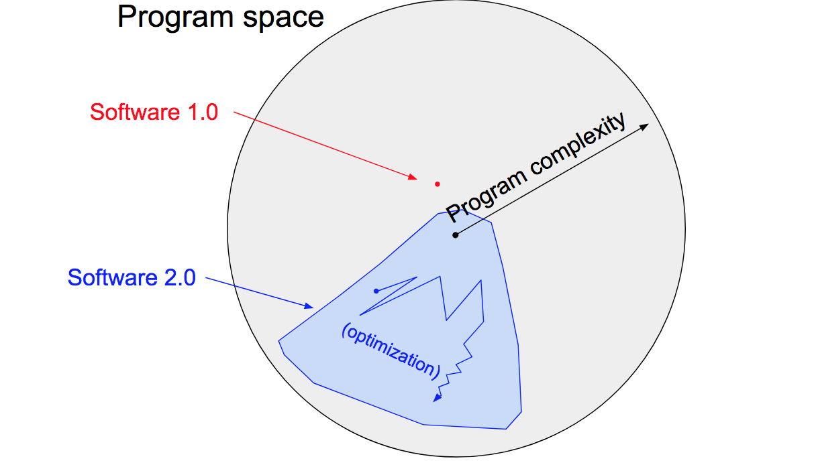
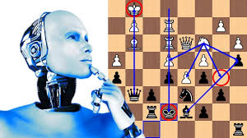
What is Software 2.0?

Slide 11
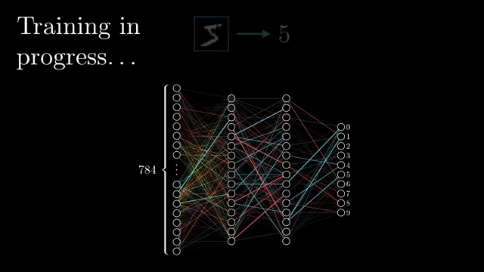
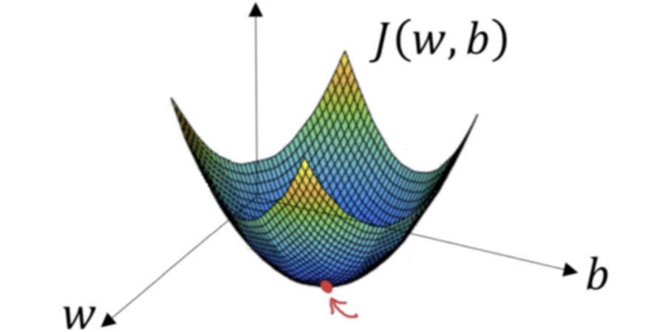
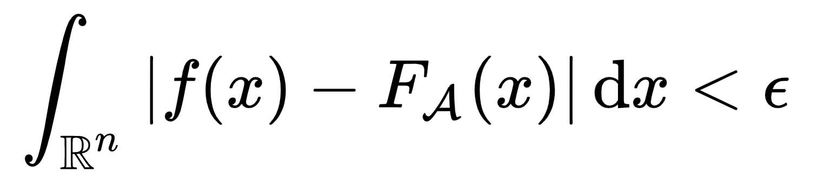
Modern Artificial Intelligence
Execute Training Cycles
Extract Rules from Data

Slide 12

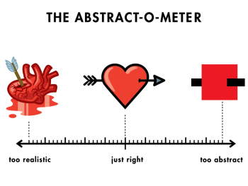
Abstraction
When you go on a higher-level abstraction, you can fit in more things in your head. You can think more.
— Christ Lantner (Creator of the LLVM)

Slide 13
The Paradigm Shift
In the past, your source code is your code. In the future, your source code is your data.

Slide 14
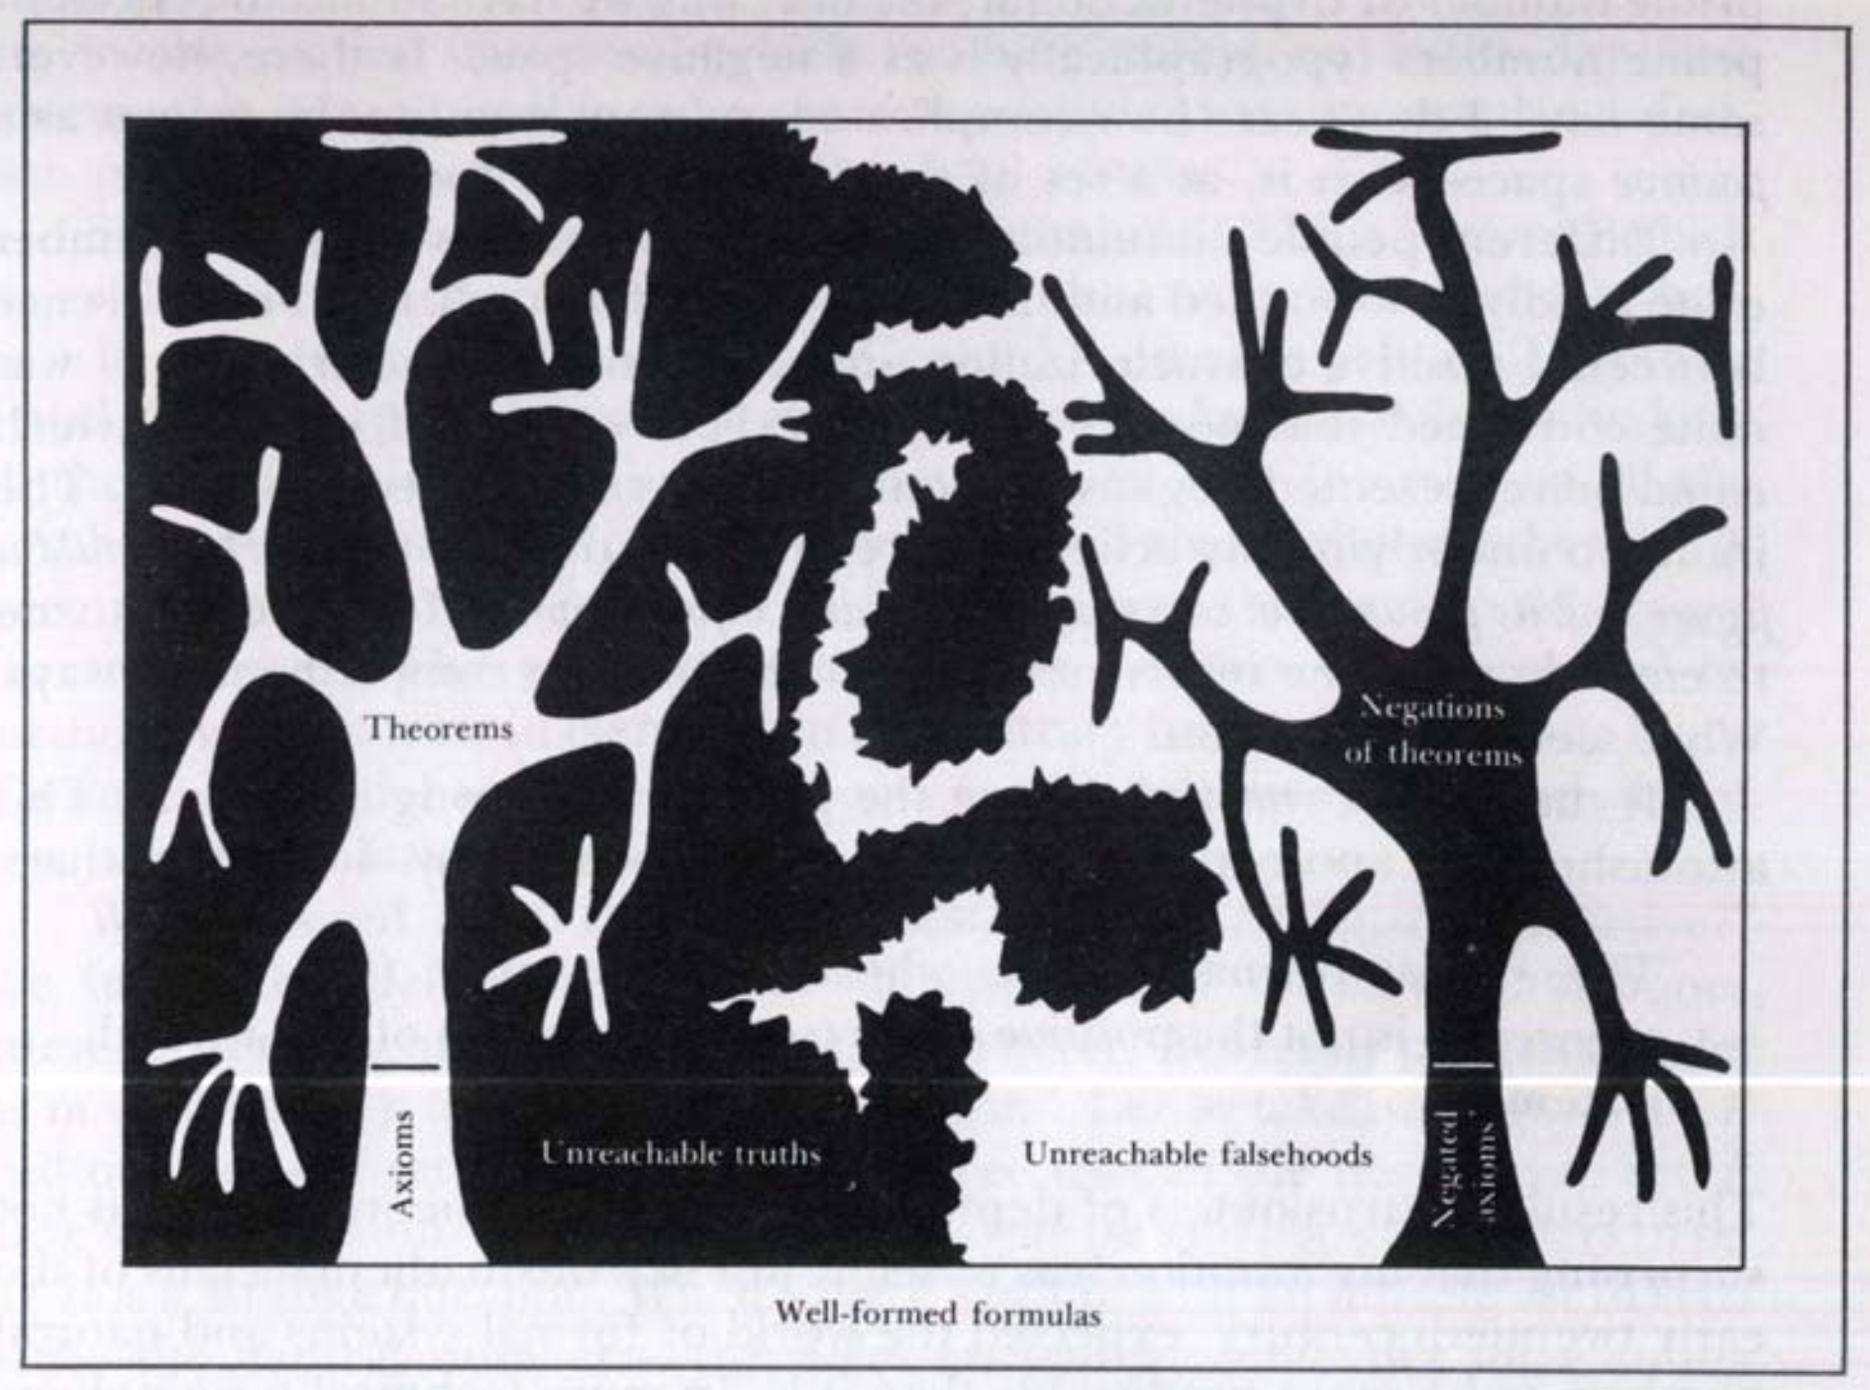
The Incompleteness Theorem
Axioms: the basics of formal systems
Win/Lose States
Rules
Listable axioms without internal contradiction
Some statements are true but cannot be proved
A system of axioms will not be able to show the systems consistency
Notes:
2. You may end up finding contradiction
Undecidability

Slide 15
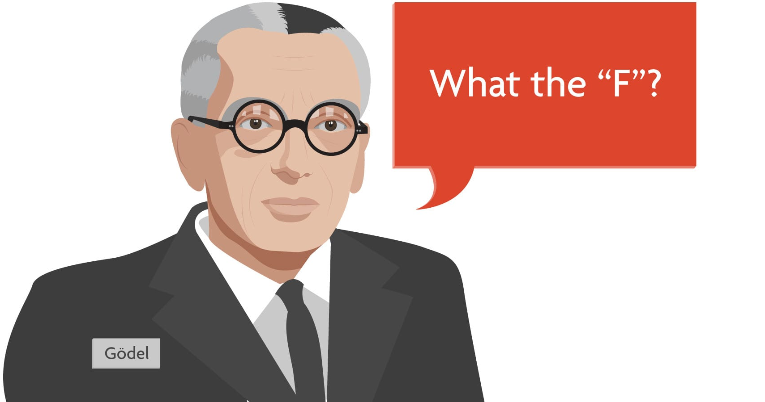

Slide 16

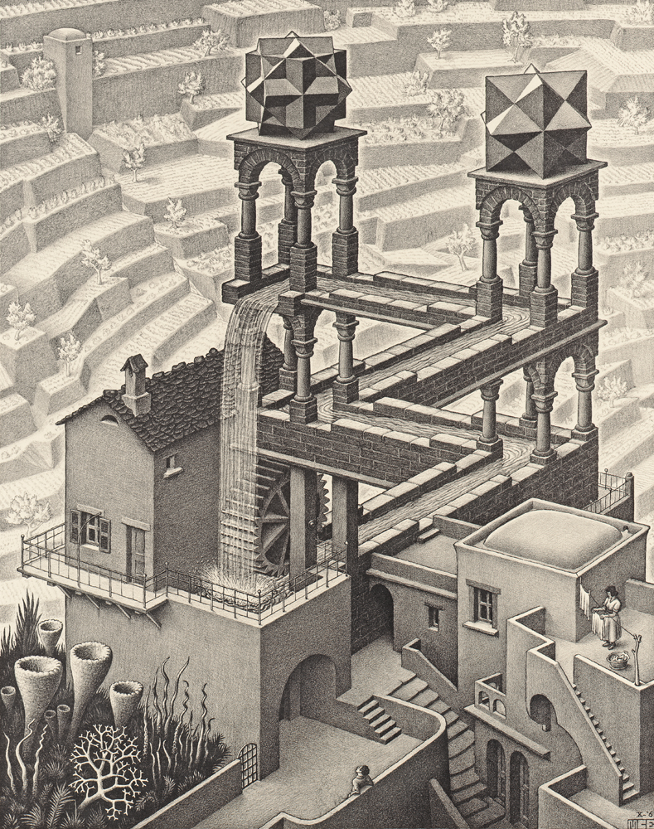
A Hint to the Next Paradigm -> The Strange Loop
"This statement is false"

Slide 17
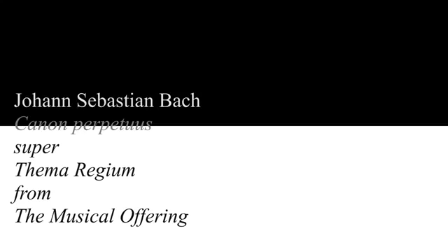
J.S. Bach - Das Musikalische Opfer (The Musical Offering)

Slide 18
How do we find the next paradigm?

